Slide 1
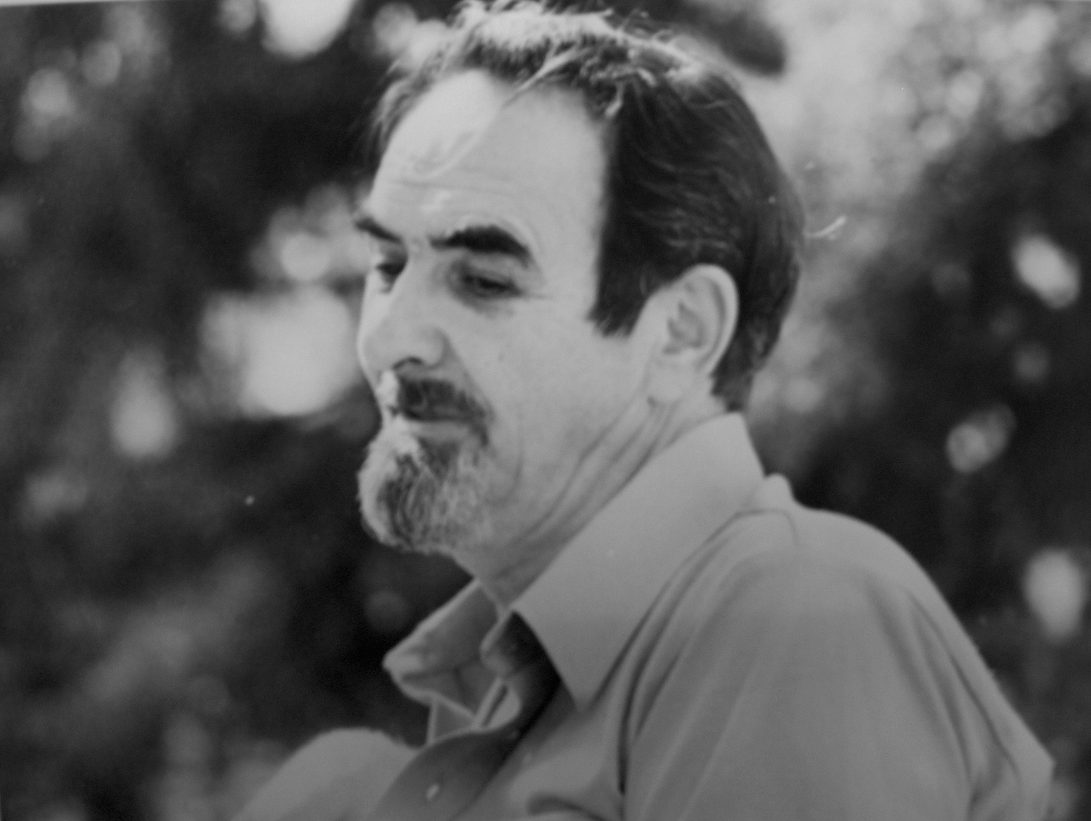
Anthony Damiani Being That Awareness

Slide 2
[Paul Reads:]
"Reason tells us that pure Thought cannot know itself because that would set up a duality which would be false if pure Thought is the only real existence.."

Slide 3
"But this is only reason's inability to measure what transcends itself. Although all ordinary experience confirms it, extraordinary experience refutes it."
--(The Notebooks of Paul Brunton 28:2.132)

Slide 4
You know it's not something far away from you. I mean it's not out, out there. It's like I said, when you close your eyes and you look within and you see this blankness. Ask yourself the question, “Who sees this blankness?”

Slide 5
Try to understand the who: who sees. Never mind what it sees: just concentrate on who sees.

Slide 6
You are always looking at something, but the one who is looking at you always forget. You're always preoccupied with what goes on so to speak on the cinemagraph, and you never look at the guy who is looking.

Slide 7
It's like when you go to the movie, you forget about yourself and you're just looking at the picture.

Slide 8
Well, that's what we're doing all the time. We're always looking at pictures. We looked at pictures so much that we forgot that WE ARE.

Slide 9
But it's right there when you close your eyes. You say, "Look I see all these thoughts running around." Never mind the thoughts. Who sees the thoughts? "Oh, I'm disturbed today." Never mind the disturbance, who sees the disturbance?

Slide 10
Always go back to the who. It's that point of light within you that you’ve got to go into and follow it through all the way. And that’s like, that’s the void that he's speaking about. Because that seer is consciousness.

Slide 11
But you’ll see, you'll think about consciousness and you're off the point. Because to think about consciousness is to put you outside of consciousness.

Slide 12
And you’ve got to try to remember: go back to who sees it and stay with that. Don't let the contents usurp your attention.

Slide 13
But the important point here Hakan, is to try to understand by being that awareness. That's the only way that it could be understood, by being that awareness

Slide 14
Then you begin to feel that you aren't anything at all, but just this infinite consciousness, no limits to it.

Slide 15
…boundless, uncircumscribed, empty of everything...

